Slide 1
Performance Management &Appraisal
Performance Management is a continuous and systematic approach that ensures the achievement of organizational business goals by streamlining employee performance and efforts to match the set goals efficiently.
Performance Appraisal is a process for evaluating and documenting how well an employee is carrying out his or her job. Performance appraisals are based on the employee's progress against goals set once a year with his or her manager.

Slide 2
Objectives of Performance Management
Develop clear role definitions, expectations and goals.
Increase employee engagement.
Develop managerial leadership and coaching skills.
Boost productivity through improved performance.
Develop a performance reward program that incentivizes accomplishment.

Slide 3
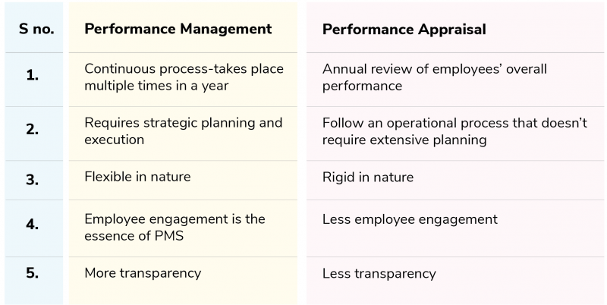
P. Management v/s P. Appraisal

Slide 4
Common Problems with P. Appraisals
Manager’s judgment or assessment based on preferences.
Unstructured methods of performance appraisal systems.
Lack of interest and ownership of manager.
Lack of a proper channel of communication.
Lack of reward and recognition policy.
Lack of leadership.
Lack of designing, monitoring and measuring the performance appraisal standards.
Lack of communication.
Overemphasizing recent performances.
No recognition/ rewards.

Slide 5
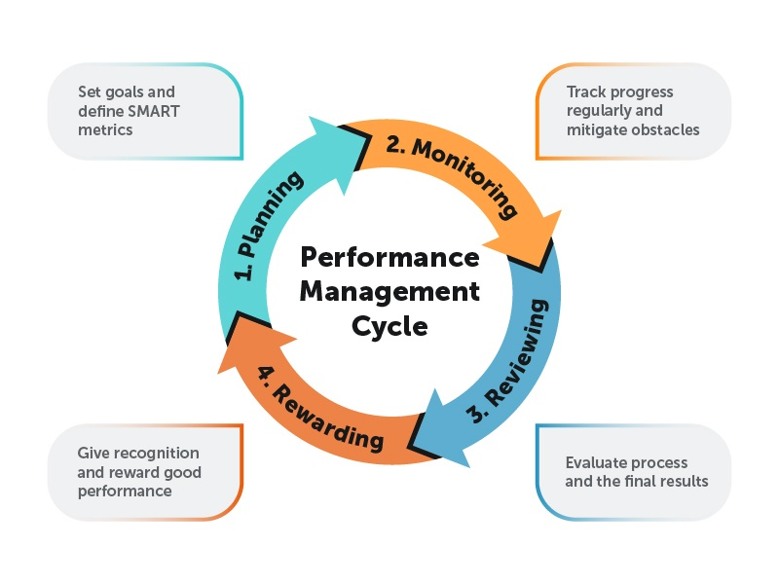
Performance Management Process
Performance Management requires that the manager should define the performance, facilitate performance and encourage performance.

Slide 6
Types of Performance Rating Systems
Performance Appraisal can be broadly classified into two categories. They are :
Traditional Methods:
(Ranking Method , Graphic Rating Scales , Critical Incident Method , Narrative Essays )
2. Modern Methods:
(Management by Objectives , Behaviorally Anchored Rating Scale (BARS) , Humans Resource Accounting , Assessment Centers , 360 Degree ).

Slide 7
1. Ranking Method :
According to Dessler et al. (2011), ranking method is ranking employees from best to worst on a particular trait, choosing highest, then lowest, until all ranked.
2.Graphic Rating Scales :
According to Dessler et al. (2011), Graphic Rating Scale is a scale that lists a number of traits and a range of performance for each. The employee is then rated by identifying the score that best describes his or her level of performance for each trait.

Slide 8
3. Critical Incident Method
According to Dessler et. al.(2011),Critical Incident method is keeping a record of uncommonly good or undesirable examples of an employee’s work related behavior and reviewing it with the employee at predetermined times.
4. Narrative Essays :
This technique mainly attempt to focus on behavior. Evaluator writes an explanation about employee’s strength and weakness points, previous performance, positional and suggestion for his (her) improvement at the end of evaluation time.

Slide 9
1. Management by Objectives:
Management by objectives (MBO) is the appraisal method where managers and employees together identify, plan, organize, and communicate objectives to focus on during a specific appraisal period.
2. Behaviorally Anchored Rating Scale (BARS) :
Behavioral anchor scales are more informative than simple numbers. BARS is a tool for evaluating employees in a defined set of performance dimensions by comparing their behaviors with specific behavior examples that anchor each performance level, usually on a five-, seven- or nine-point scale.

Slide 10
3. Humans Resource Accounting :
HRA is the process of Assigning, budgeting, and reporting the cost of human resources incurred in an organization, including wages and salaries and training expenses.
It analyses an employee's performance through the monetary benefits he/she yields to the company. It is obtained by comparing the cost of retaining an employee (cost to company) and the monetary benefits (contributions) an organization has ascertained from that specific employee

Slide 11
4. Assessment Centers :
Under this an employee is evaluated on critical competencies necessary for their job using job-related simulations and exercises.
5. 360 Degree :
It involves evaluation input from multiple levels within the firm as well as external sources.360 Degree feedback relies on the input of an employee’s superior, colleagues, subordinates, sometimes customers, suppliers and/or spouses.
It provides people with information about the effect of their action on others in the workplace

Slide 12
Future of Performance Management
The end of the annual review ( Continuous Performance Reviews Are the New Normal).
The future lies in tech (AI-Powered Performance Insights & Predictive Analytics).
An equitable system.
Linking Performance with Well-Being.
Transparent & Data-Driven Evaluation Systems.
Multi-Dimensional Feedback: 360° Is Here to Stay.

